Slide 1
Groundwater
Notes:
Students can view the online module about groundwater at: https://www.meted.ucar.edu/index.php . There is one called “understanding the Hydrological Cycle” and another one on Watersheds that has a section on Water Quality.

Slide 2
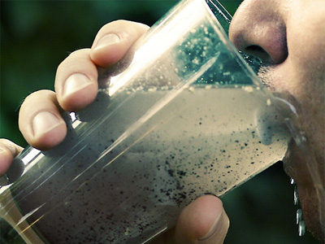
What is groundwater?

Slide 3
Aquifers and Groundwater
Groundwater: any water that is found underground in cracks and spaces in soil, sand, and rocks

Slide 4
Groundwater Mining
Removing water from an aquifer faster than it can be replenished.
Extended periods of mining can lead to:
Land subsidence.
Lowering of the water table.
Salt-water intrusion of wells near coastal areas.
More than half of the US relies on groundwater for drinking water (New York: 35%)

Slide 5
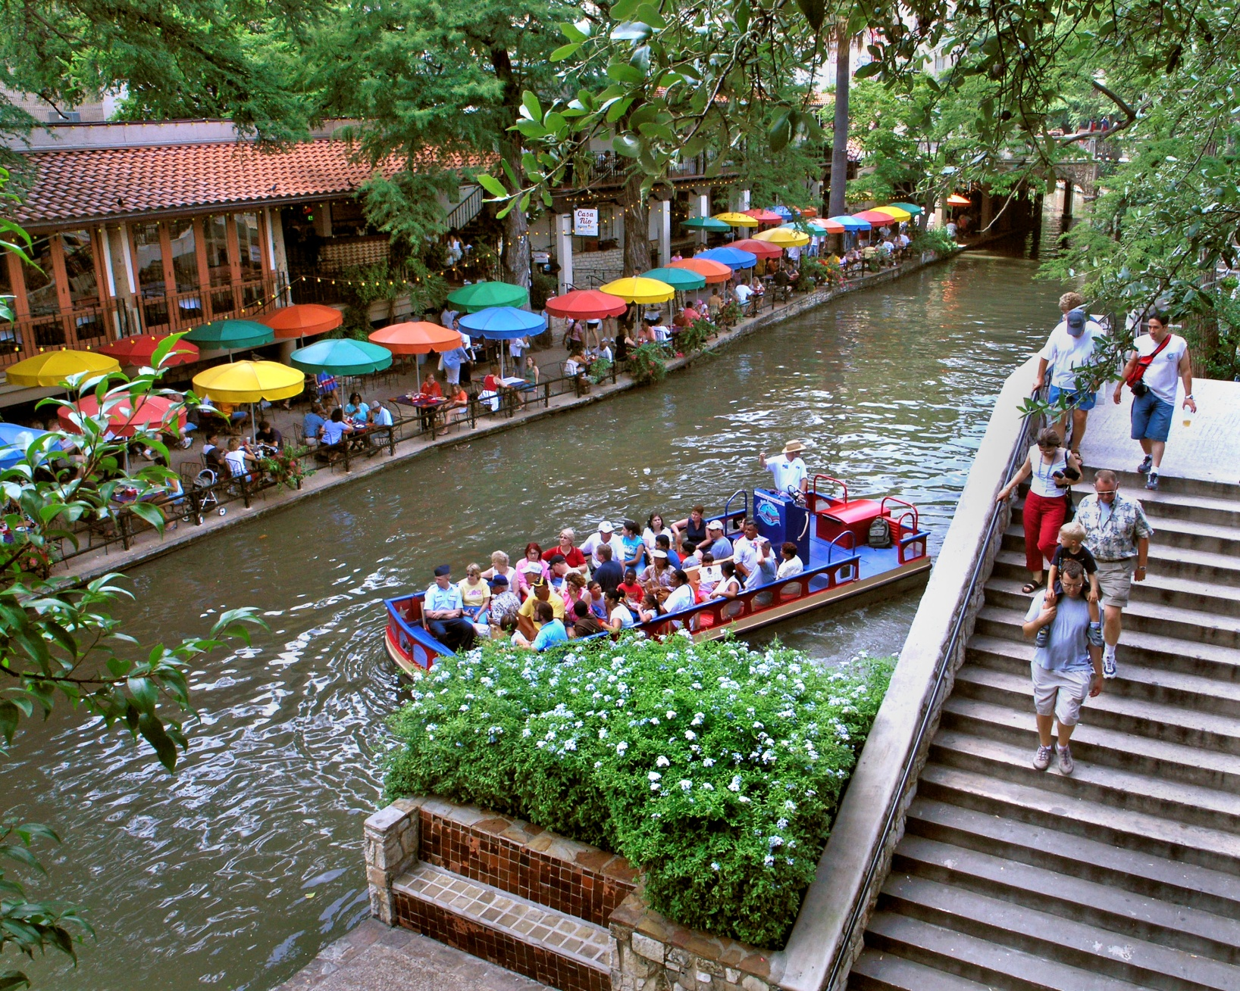
Notes:
San Antonio has been pumping groundwater for its river since 1911. Once a year, they drain it to clean. They pump 10 million gallons a day into the city from the Edwards Aquifer. The city relies on the aquifer for 99% of its municipal supply. In the future, the city plans to pump water from an aquifer 200 miles north of the city.

Slide 6
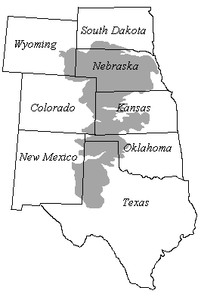
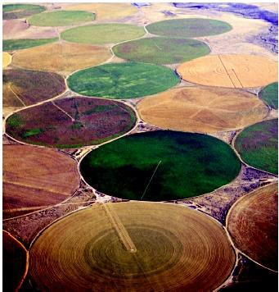
Groundwater depletion example: Ogallala Aquifer

Slide 7
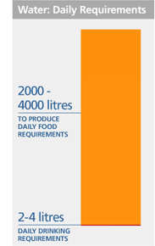
Ogallala Aquifer
Before 1940s, water couldn’t be accessed if it was below 70-80 feet
Technology allowed wells to extract water from more then 3,000 feet
By 1990, sixteen million acres of the high plains were irrigated with water from Ogallala
Some areas: more than 150 foot declines
www.unwater.org

Slide 8
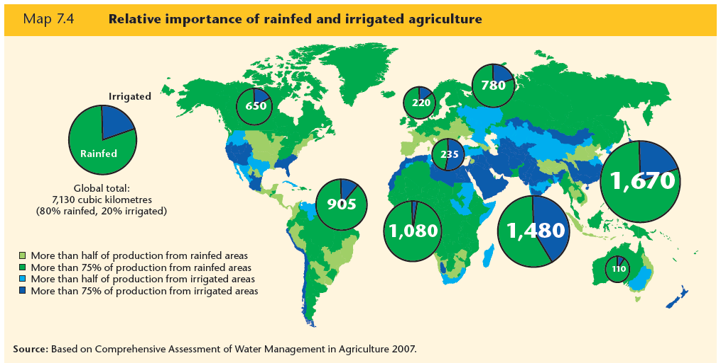
Much of the world relies on irrigation from groundwater instead of rain for agriculture- notice India!
3rd UN World Water Development Report, 2009
Notes:
Ask students to think about what happens when groundwater runs dry…

Slide 9
How salt accumulates in an ecosystem and then reaches steady state

Slide 10
Year 0 - Input 0 molecules of NaCl into the system
Watershed
Stream
Output 0 NaCl molecules to the stream
NaCl molecule =
We will add 7 molecules of salt every year- representing the fact that the same amount of salt is used every year- not an increasing amount.
Ecosystem =

Slide 11
Year 1 - Input 7 NaCl molecules
Output 3 NaCl molecules to the stream
Note 4 remaining in system that carry over to next year
NaCl molecule =
Ecosystem =

Slide 12
Year 2 – Input another 7 molecules to the system, add 4 molecules remaining from previous year =11 molecules
Output 4 NaCl molecules to the stream
Note 7 remaining in system that carry over to next year
NaCl molecule =
Ecosystem =

Slide 13
Year 3 – Input another 7 molecules, add 7 remaining from previous year = 14 molecules
Output 5 NaCl molecules to the stream
Note 9 remaining in system that carry over to next year
NaCl molecule =
Ecosystem =

Slide 14
Year 4 – Input another 7 molecules, add 9 molecules remaining from previous year =16 molecules
Output 6 NaCl molecules to the stream
Note 10 remaining in system that carry over to next year
NaCl molecule =
Ecosystem =

Slide 15
Year 5 - Input another 7 molecules, add 10 molecules remaining from previous year = 17 molecules
Output 7 NaCl molecules to the stream
Note 10 remaining in system that carry over to next year
NaCl molecule =
Ecosystem =

Slide 16
Year 6 – Input another 7 molecules, add 10 molecules remaining from previous year = 17 molecules
Steady State Reached, System Is At Equilibrium
Output 7 NaCl molecules to the stream
NaCl molecule =
Ecosystem =

Slide 17
What does it look like if you plot stream NaCl?

Slide 18
What happens if you stop inputting NaCl?

Slide 19
Year 7 – Cease input, 10 molecules remaining from previous year
Output 4 NaCl molecules
NaCl molecule =
Ecosystem =

Slide 20
Year 8 - Input 0 molecules, add 6 molecules remaining from previous year = 6 molecules
Output 3 NaCl molecules
NaCl molecule =
Ecosystem =

Slide 21
Year 9 – Input 0 molecules, add 3 molecules remaining from previous year = 3 molecules
Output 2 NaCl molecules
NaCl molecule =
Ecosystem =

Slide 22
Year 10 – Input 0 molecules, add 2 molecules remaining from previous year = 0 molecules
Output 2 NaCl molecules
NaCl molecule =
Ecosystem =

Slide 23
Year 11 – Input 0 molecules, 0 molecules remaining from previous year
Output 0 NaCl molecules
NaCl molecule =
Ecosystem =

Slide 24
Now what does it look like if you plot stream NaCl?
Note that it takes as long to reach 0 concentration as it did to reach steady state.

