Slide 3
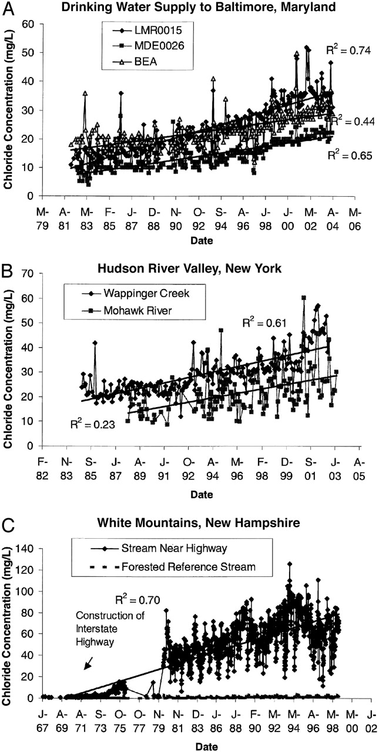
Examples of significant, long-term increases in baseline concentration of chloride for streams and rivers of the northeastern United States.
Kaushal S S et al. PNAS 2005;102:13517-13520
©2005 by National Academy of Sciences
Notes:
Examples of significant, long-term increases in baseline concentration of chloride for streams and rivers of the northeastern United States. The R2 values are given for linear regressions. All streams and rivers are located in rural areas but contain roads within their watersheds. (A) LMR0015 (Little Morgan Run), MDE0026 (Middle Run), and BEA (Beaver Run) are sampling stations for tributaries to Liberty Reservoir, a drinking water supply for Baltimore. (B) Wappinger Creek and the Mohawk River are tributaries to the Hudson River in the Hudson River Valley. (C) The streams in the White Mountains drain into Mirror Lake; one is located near an interstate highway in the Hubbard Brook Valley, and the forested reference stream is watershed 6 of the Hubbard Brook Experimental Forest (10).

Slide 4
How salt accumulates in an ecosystem and then reaches steady state
Vicky Kelly
Cary Institute of Ecosystem Studies

Slide 5
Year 0 - Input 0 molecules of NaCl into the system
Watershed
Stream
Output 0 NaCl molecules to the stream
NaCl molecule =
We will add 7 molecules of salt every year- representing the fact that the same amount of salt is used every year- not an increasing amount.
Ecosystem =

Slide 6
Year 1 - Input 7 NaCl molecules
Output 3 NaCl molecules to the stream
Note 4 remaining in system that carry over to next year
NaCl molecule =
Ecosystem =

Slide 7
Year 2 – Input another 7 molecules to the system, add 4 molecules remaining from previous year =11 molecules
Output 4 NaCl molecules to the stream
Note 7 remaining in system that carry over to next year
NaCl molecule =
Ecosystem =

Slide 8
Year 3 – Input another 7 molecules, add 7 remaining from previous year = 14 molecules
Output 5 NaCl molecules to the stream
Note 9 remaining in system that carry over to next year
NaCl molecule =
Ecosystem =

Slide 9
Year 4 – Input another 7 molecules, add 9 molecules remaining from previous year =16 molecules
Output 6 NaCl molecules to the stream
Note 10 remaining in system that carry over to next year
NaCl molecule =
Ecosystem =

Slide 10
Year 5 - Input another 7 molecules, add 10 molecules remaining from previous year = 17 molecules
Output 7 NaCl molecules to the stream
Note 10 remaining in system that carry over to next year
NaCl molecule =
Ecosystem =

Slide 11
Year 6 – Input another 7 molecules, add 10 molecules remaining from previous year = 17 molecules
Steady State Reached, System Is At Equilibrium
Output 7 NaCl molecules to the stream
NaCl molecule =
Ecosystem =

Slide 12
What does it look like if you plot stream NaCl?

Slide 13
What happens if you stop inputting NaCl?

Slide 14
Year 7 – Cease input, 10 molecules remaining from previous year
Output 4 NaCl molecules
NaCl molecule =
Ecosystem =

Slide 15
Year 8 - Input 0 molecules, add 6 molecules remaining from previous year = 6 molecules
Output 3 NaCl molecules
NaCl molecule =
Ecosystem =

Slide 16
Year 9 – Input 0 molecules, add 3 molecules remaining from previous year = 3 molecules
Output 2 NaCl molecules
NaCl molecule =
Ecosystem =

Slide 17
Year 10 – Input 0 molecules, add 2 molecules remaining from previous year = 0 molecules
Output 2 NaCl molecules
NaCl molecule =
Ecosystem =

Slide 18
Year 11 – Input 0 molecules, 0 molecules remaining from previous year
Output 0 NaCl molecules
NaCl molecule =
Ecosystem =

Slide 19
Now what does it look like if you plot stream NaCl?
Note that it takes as long to reach 0 concentration as it did to reach steady state.

Slide 20
Winter vs Summer Stream Flow for use with Lesson 2 extension

Slide 21
Summer Stream Flow

Slide 22
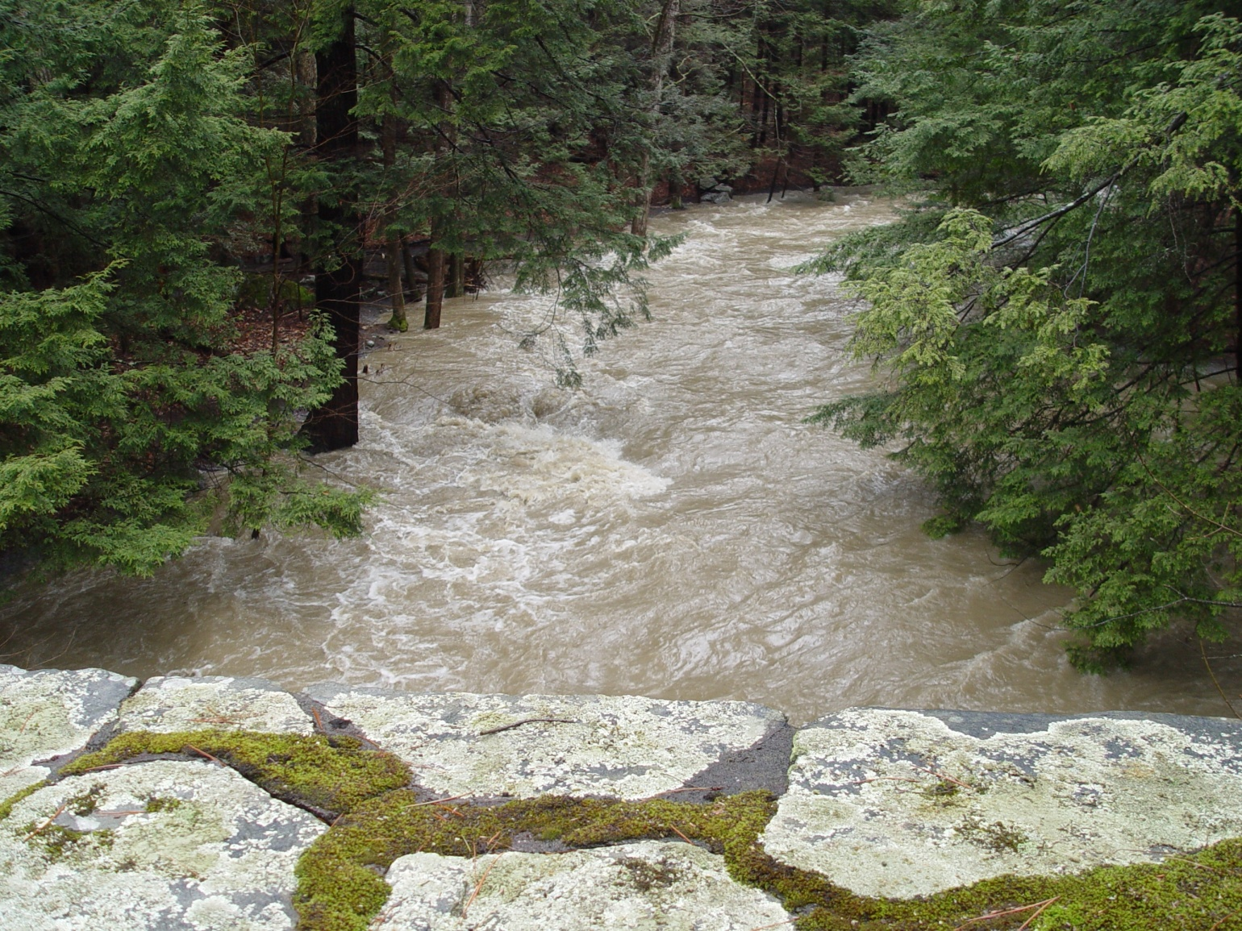
Winter Stream Flow
Notes:
Trees are coniferous so they are always green

Slide 23
Summer vs. Winter Stream Flow
Flow is higher in winter than summer

Slide 24
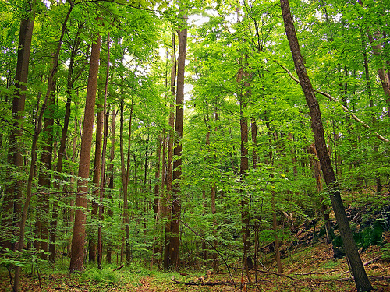
Summer Deciduous Forest

Slide 25
Summer Rain
About 17 inches of rain falls in the summer (May-August)
Convert that to meters: 17 in. = 0.43 meters
The watershed upstream from our gauging station is about 6000 hectares
1 hectare = 10,000 m^2, so our watershed is 60,000,000 m^2
60,000,000 m^2 x 0.43 m of rain = 25,800,000 m^3, which = 6,815,638,951 gallons
That’s the total volume of rain that falls on our watershed from May-August

Slide 26
How much do trees take up?
Each tree takes up about 30 gallons of water per day
There are about 2000 trees per hectare in our forest
So 2000 trees x 6000 ha = 12,000,000 trees in our watershed
Multiply the number of trees by 30 gallons and you get
360,000,000 gallons per day.
Multiply that by the number of days in May-August (123) and you get
44,280,000,000 gallons taken up by trees each summer.

Slide 27
Let’s compare:
Volume of rain:
6,815,638,951
Volume taken up by trees:
44,280,000,000
How can that be?
30 gallons in a day is what the trees will take up if that much water is available, which there isn’t always. They will take up all the water they can though, so in the end, the trees take all of the rain that falls in the summer, unless it’s a super wet summer.

Slide 28
What happens in winter?
Remember that flow is higher in winter than summer

Slide 29
Does more precipitation fall in the winter or the summer?

Slide 30
Some people think the flow is higher in winter because there’s more precipitation in the winter, but there’s actually more precipitation (on average) in summer

Slide 31
How much precipitation falls in winter?
11.78 inches of rain falls from November through February
If you do all those calculations we did for summer, you get:
4,752,000,000 gallons of water falls from November to February.

Slide 32
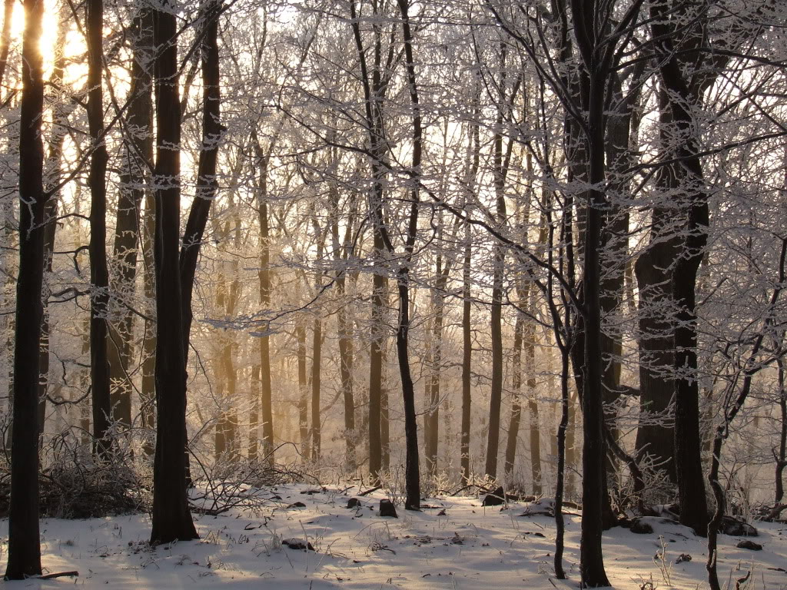
How much gets taken up by trees?

Slide 33
How much gets taken up by trees?
0 gallons because the trees are dormant, there are no leaves on the trees
All of the precipitation runs into the streams
And that is why the stream flow is higher in winter than summer!

Slide 34
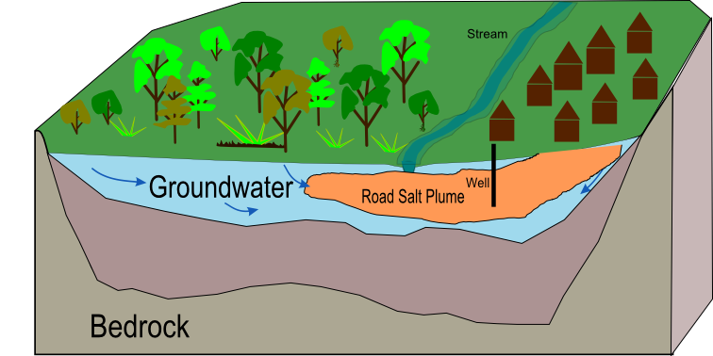
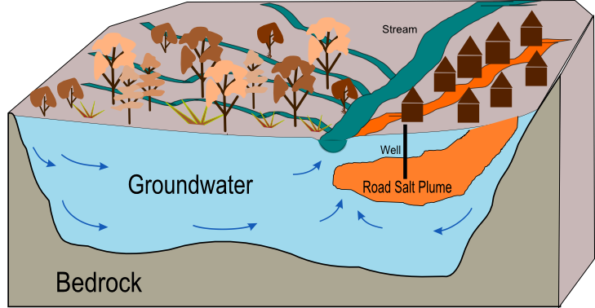
Notes:
Groundwater in summer and in winter

Slide 35
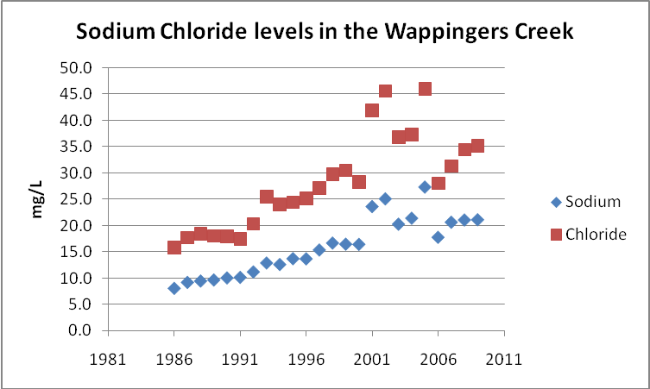
Data are from the Cary Institute of Ecosystem Studies’ Environmental Monitoring Program

